Slide 1

JAVA PROJECT
DICE SPLIT
BY
SESAN POPOOLA & ABDUL AZIZ
16TH JULY 2024

Slide 2
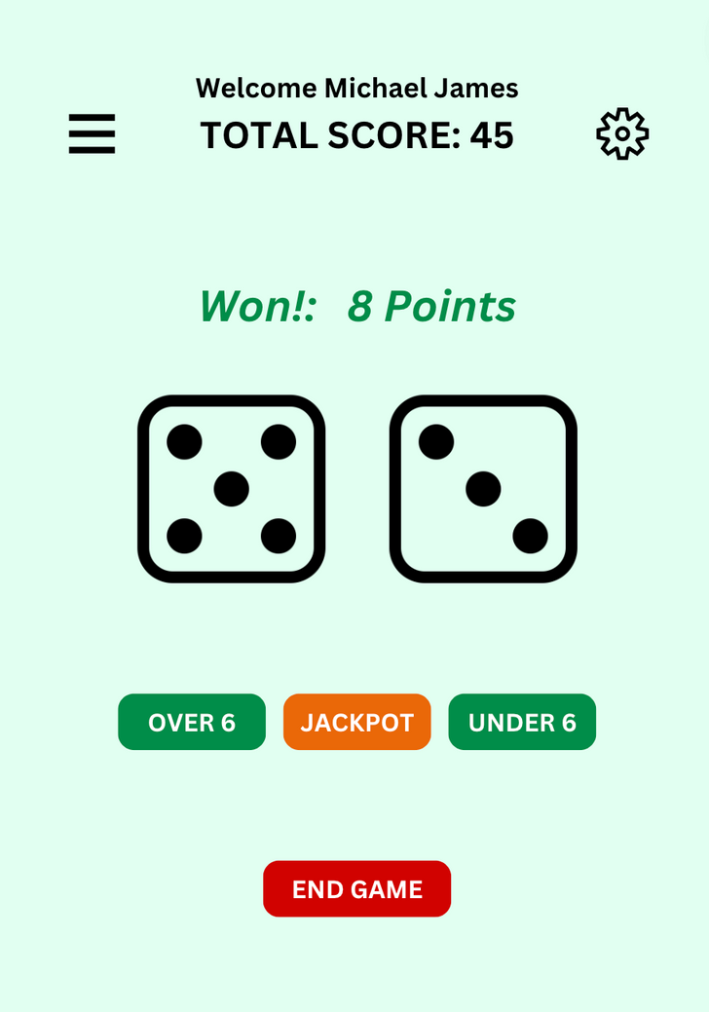

2
Project Concept & Idea
3
2
This project was an original idea, we never sorted out game dynamic ideas from any previously built game. We made a plan, put what we wanted together and started building.
Most of the decisions we made came as we made progress with the codes. On the right, you will find what our original outlook for the game was.
As we make progress with the presentation, you will see what we ended up with, comparing our finished product to the initial idea we had.
The application ended up looking way better than what we imagined.
3
4
5
6
7
8
9

Slide 3
100+
Hours
Inputs & Obstacles
2
3
On the right you will find a few stats. It took around 100+ combined hours of coding to ge the job done. We also had to iterated through color schemes and desing ideas more than 20 times and we ended up writing around 1,500 lines of codes to make the application look as presented today.
While it was a combined team effort, Abdul spent more time working on the home page and credit page while i worked on the Main game page and settings page.
Gamelogic, animations and sound effects was a complete team work as we both had our part to play.
The way we split the work between ourselves made it possible for a smooth work between myself and Abdul.
Every code idea used to build this project was taught by the professor, we never really needed any outside help, and there was really no obstacle that a little brainstorming couldn’t fix
2
20+
Design Iterations
3
4
5
6
1,500+
Lines Of Codes
7
8
9

Slide 4
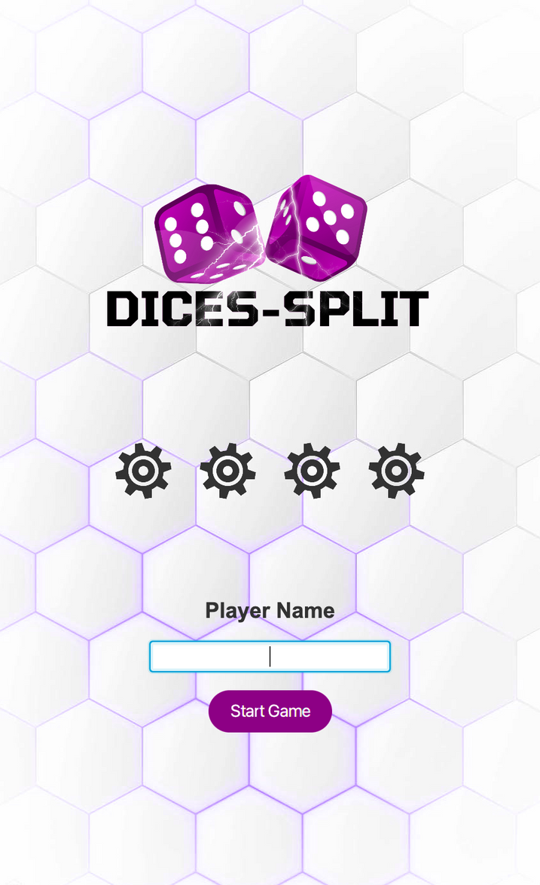
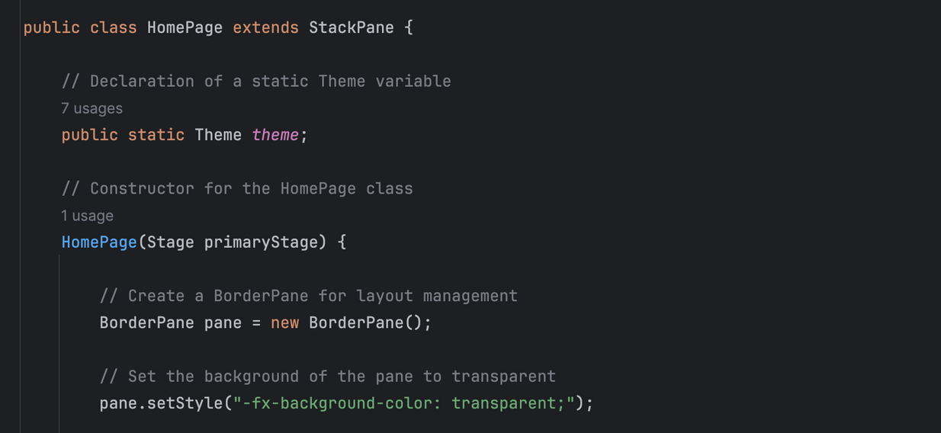
INTRODUCTION
HOME PAGE
1
The image on the right shows the launch page (Home Page). A player can decide to enter their name to start the game or not. This page is designed to be as simple as possible to get rid of any distractions so players can get straight into the action.
The page extends a stack pane so, a border pane with all the necessary nodes is stacked on top the page with a transparent background so the background design is visible.
2
3
4
5
6
7
8
9

Slide 5
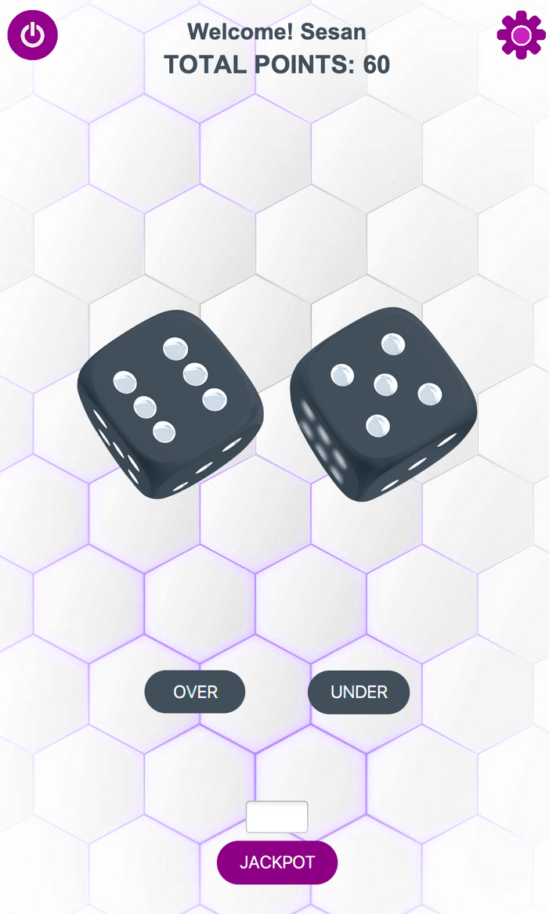
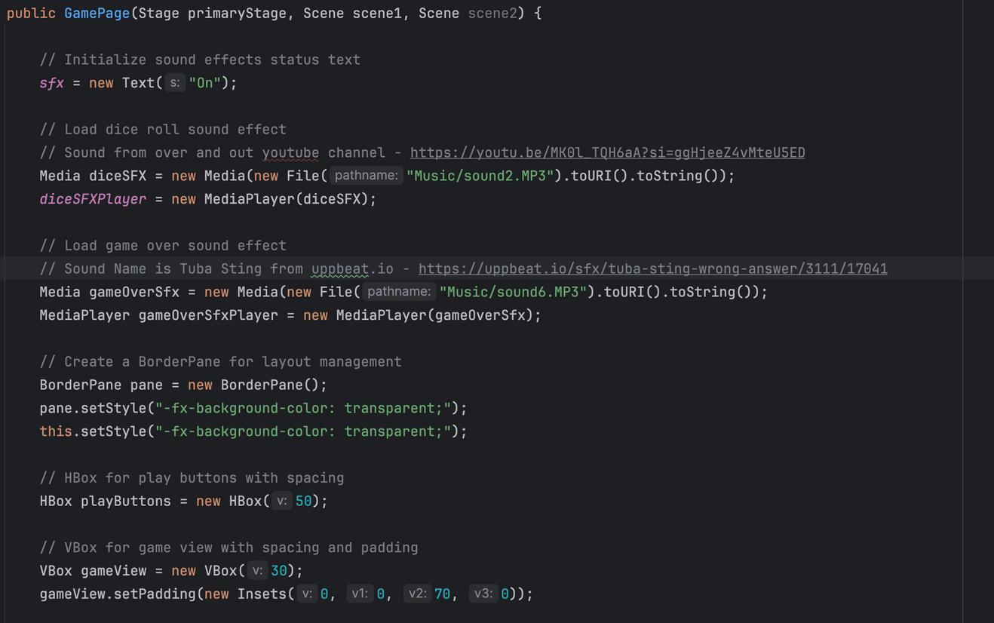
Main Game
1
Just like the home page, the game page extends a stack pane and a border pane containing all the nodes stacked on top.
There are 3 main buttons to play the game. Over, Under and Jackpot, Here’s a code snippet for a quick overview
2
3
4
5
6
7
8
9

Slide 6
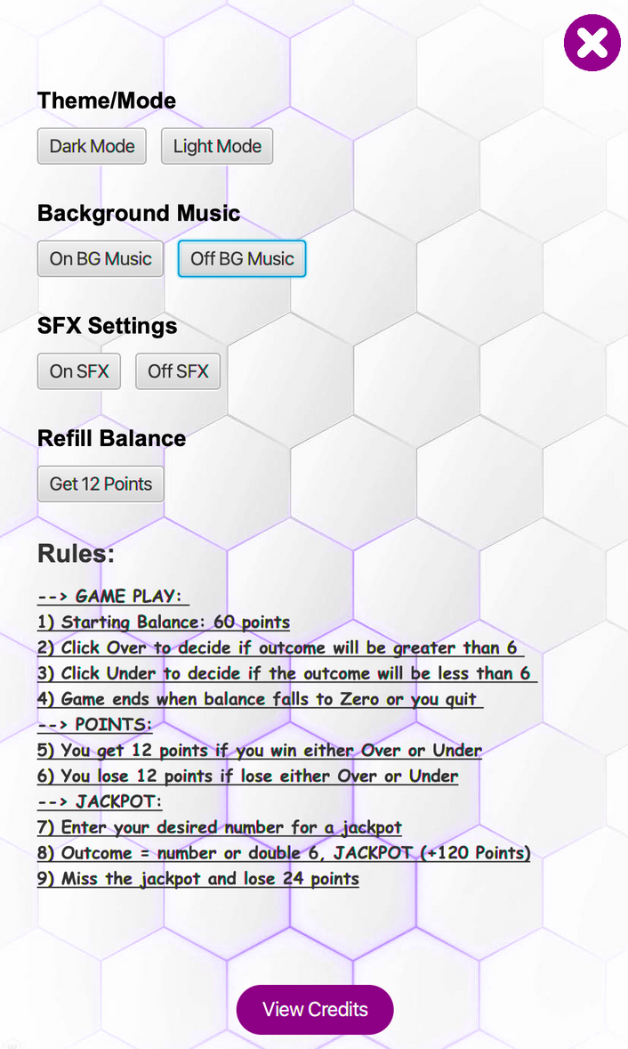
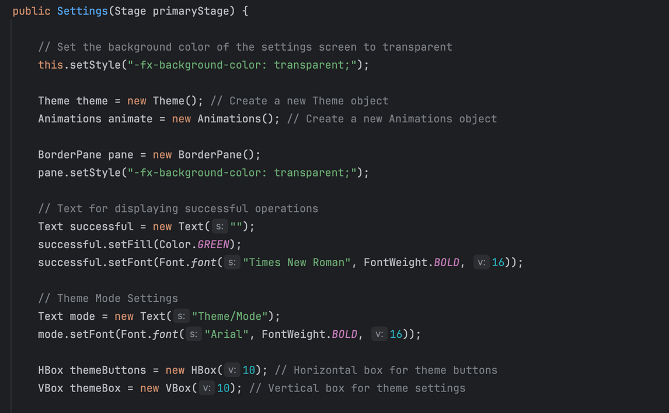
Settings Page
On the right, you will find the settings page where most of the game controls can be made, You can turn of and on background music and sound effects. Change from light to dark mode,
refill your balance and also find a list of the game rules to help the player get acquainted with the game.
1
2
3
4
5
6
7
8
9

Slide 7
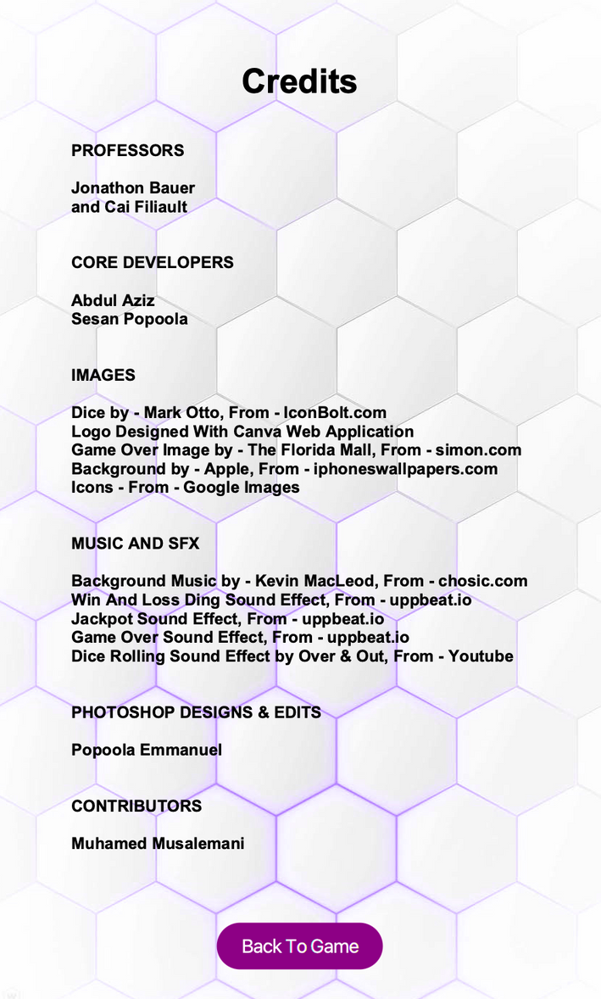
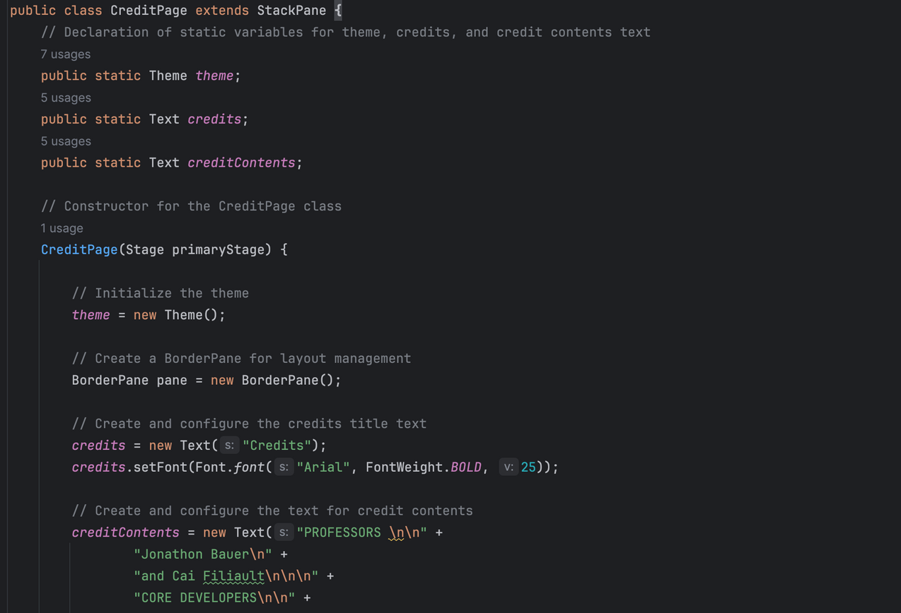
Credits Page
1
On the right, you’s find the credit page where all course and credits have been attributed accordingly.
You can find the code snippet below;
2
3
4
5
6
7
8
9

Slide 8
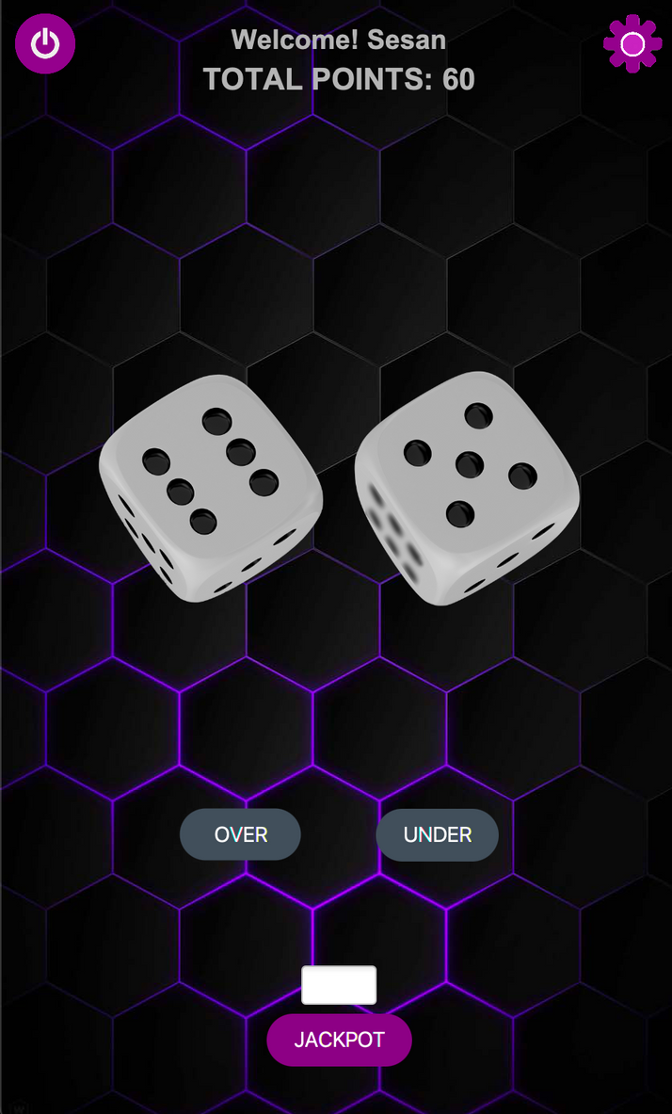
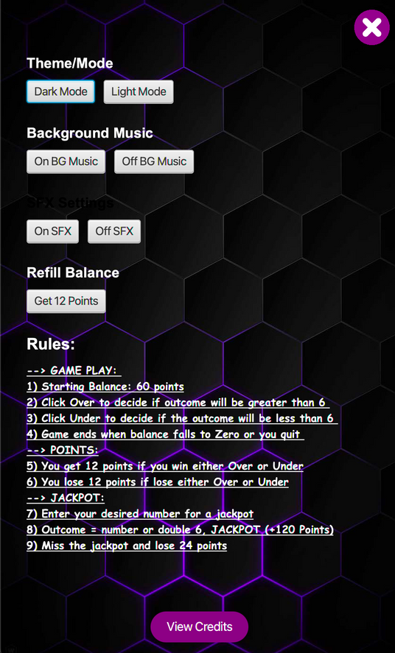
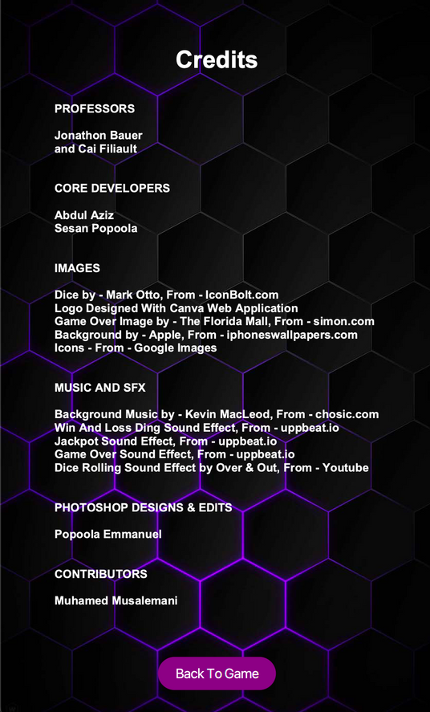
Dark Mode
1
Here are some images of the Dark theme mode
2
3
4
5
6
7
8
9

Slide 9
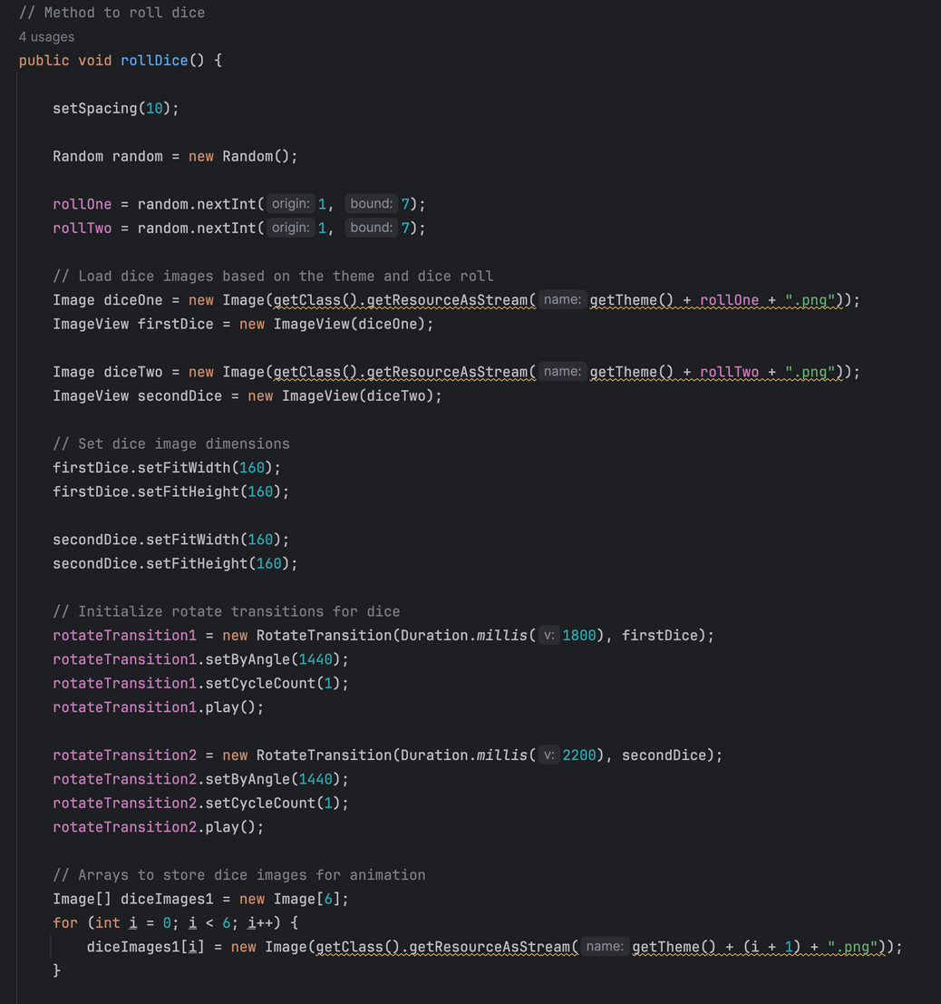
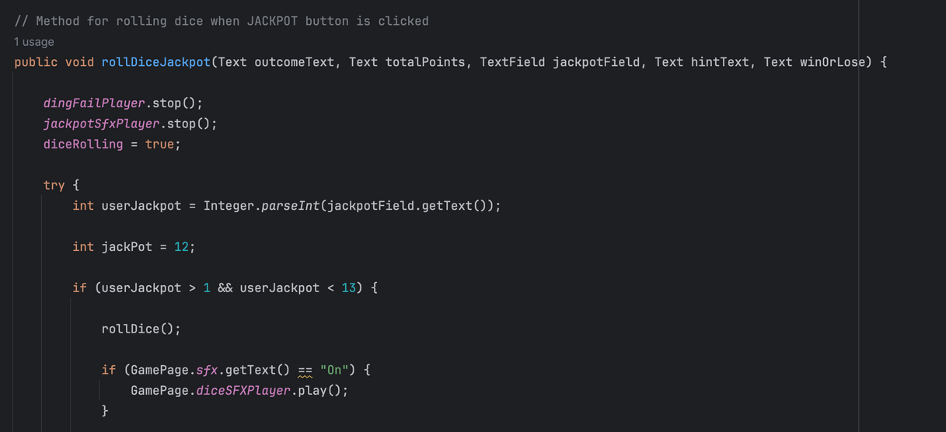
Game Logic
There’s a subclass called GameLogic, as the name implies, this is where all the codes related to gameplay are placed, there’s over 400 lines of codes and they’re all methods for different actions.
On the right, you will find a method to roll dice whenever a player decides to play.
Below is a method to handle the logic behind the Jackpot which is invoked whenever the Jackpot button is clicked. It also perfectly handles exceptions.
1
2
3
4
5
6
7
8
9

Slide 10
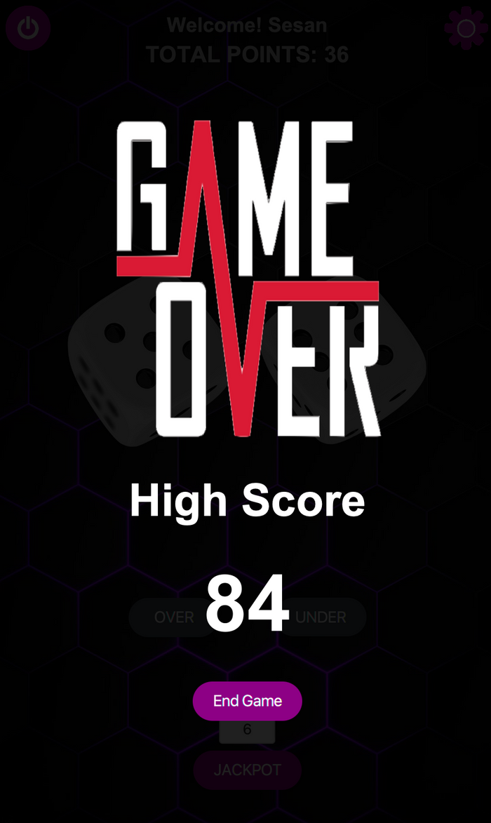
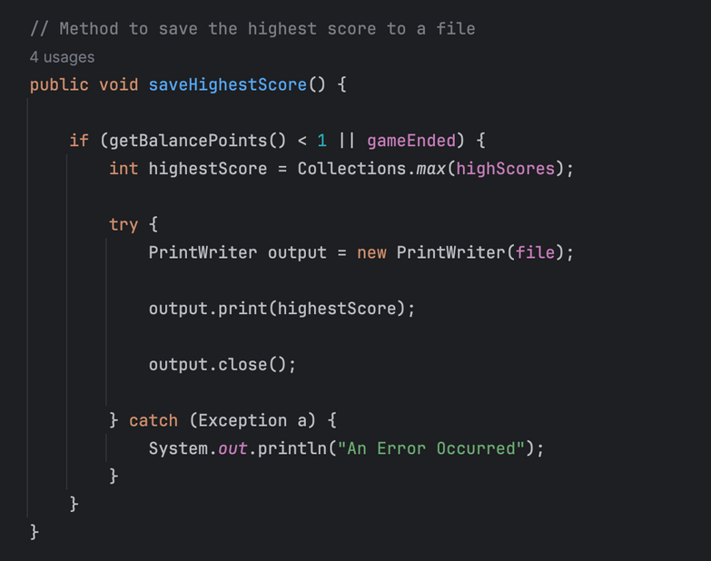
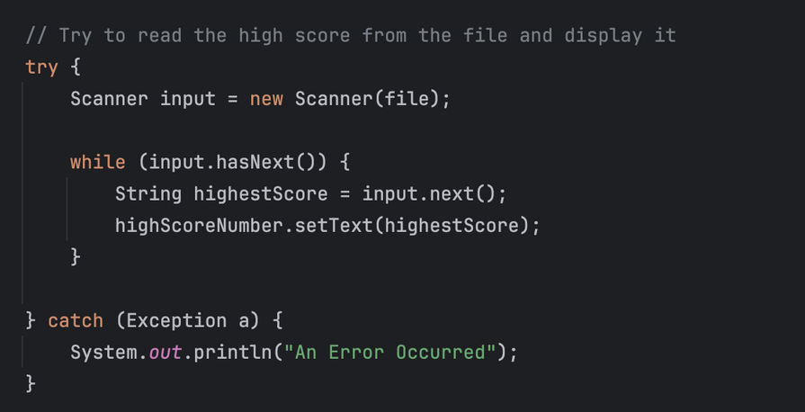
File I/O
File I/O was used to handle the high score logic when the game ends. During the game, an array list is used to store users scored points. As soon as the game ends, it produces the highest score the user had before the game ends and saves it to the high score text file.
This high score file is then read and the highest score is printed on the game over page as you can see on the right.
Below are the code snippet to save the highest score to file in the Game Logic class and to read highest score from file in the Game Over Class
1
2
3
4
5
6
7
8
9

Slide 11
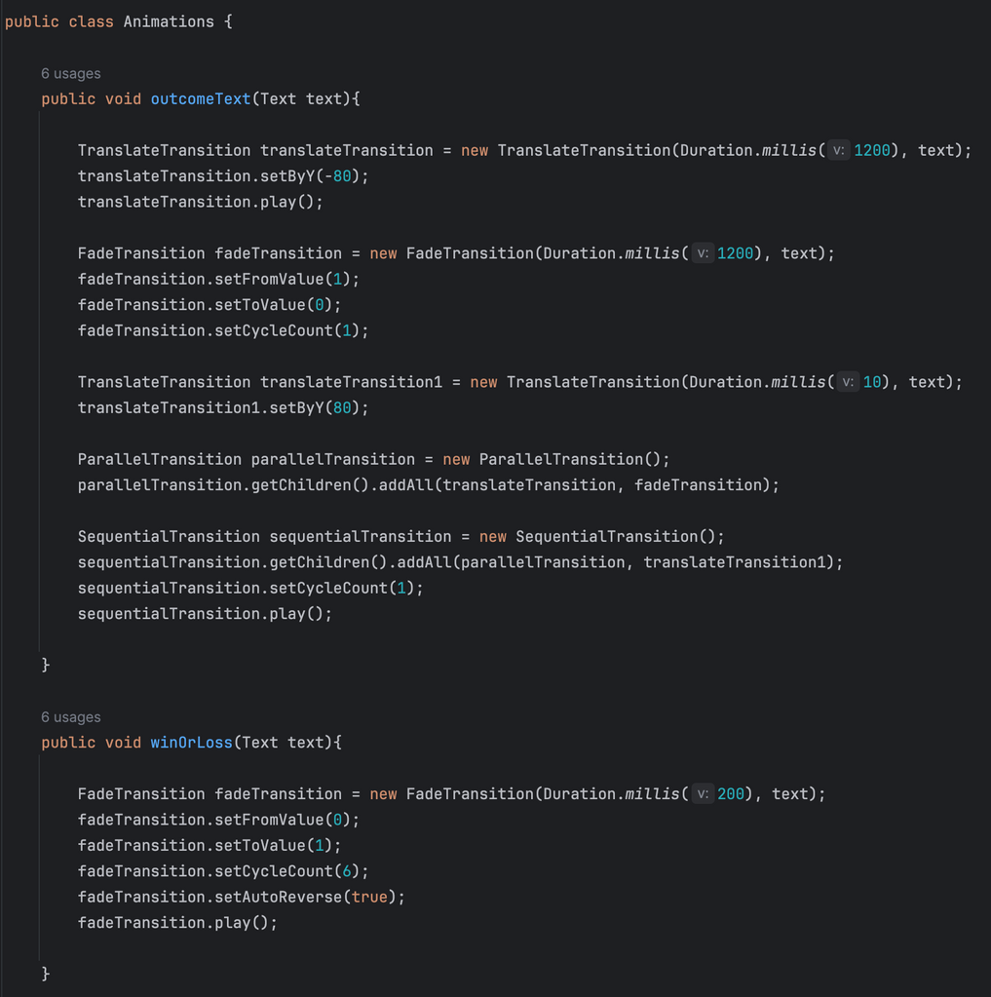
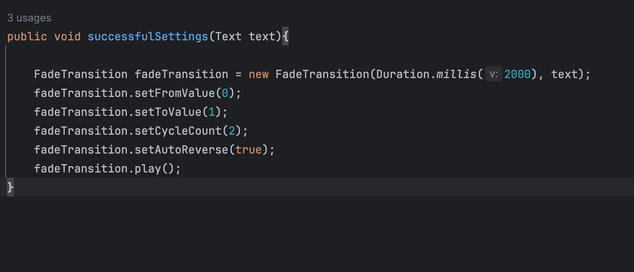
Animations
1
Animations were used to add some graphical appeal to the game and also make the game play enjoyable. We used them for the spinning dice, when points where being recorded and on the home page.
Most codes related to animations can be found in the Animation class. You can see the code snippet on the right and at the bottom of this page.
2
3
4
5
6
7
8
9

Slide 12
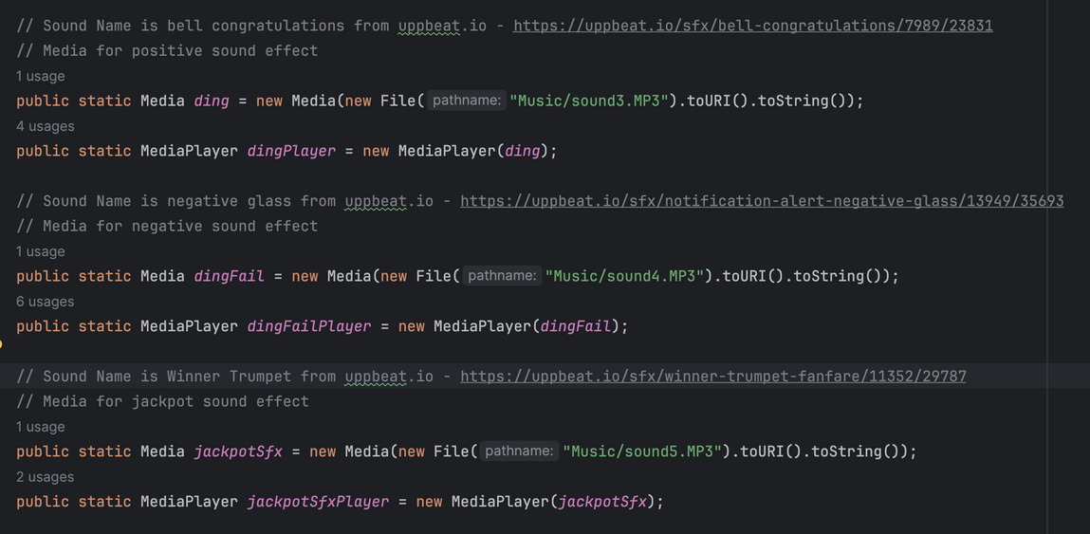
Sound Effect & Background Music
1
Sound effects are an essential part of an enjoyable game, so we added a few. There’s a total of 5 sound effects and a background music.
1) There’s a sound effect for the rolling dice
2) For a positive point addition when you win
3) For a negative point subtraction when you loose
4) For successfully winning a Jackpot
5) For when the game ends
6) A general background music
Background music and sound effects can be turned off and on in the settings page.
2
3
4
5
6
7
8
9

Slide 13

1
2
3
4
5
6
7
Thank You
8
9

